Slide 1
Ants
Uva 1411
NEERC 2008, LA4043
3 seconds

Slide 2
Problem Descriptions (1/2)
Young naturalist Bill studies ants in school. His ants feed on plant-louses that live on apple trees. Each ant colony needs its own apple tree to feed itself. Bill has a map with coordinates of n ant colonies and n apple trees. He knows that ants travel from their colony to their feeding places and back using chemically tagged routes. The routes cannot intersect each other or ants will get confused and get to the wrong colony or tree, thus spurring a war between colonies.

Slide 3
Problem Descriptions (2/2)
Bill would like to connect each ant colony to a single apple tree so that all n routes are non-intersecting straight lines. In this problem such connection is always possible. Your task is to write a program that finds such connection.
On the picture ant colonies are denoted by empty circles and apple trees are denoted by filled circles. One possible connection is denoted by lines.

Slide 4
Input
Input has several dataset. The first line of each dataset contains a single integer number n (1 ≤ n ≤ 100) — the number of ant colonies and apple trees.
It is followed by n lines describing n ant colonies, followed by n lines describing n apple trees. Each ant colony and apple tree is described by a pair of integer coordinates x and y (−10000 ≤ x, y ≤ 10000) on a Cartesian plane. All ant colonies and apple trees occupy distinct points on a plane. No three points are on the same line.

Slide 5
Output
For each dataset, write to the output file n lines with one integer number on each line. The number written on i-th line denotes the number (from 1 to n) of the apple tree that is connected to the i-th ant colony. Print a blank line between datasets

Slide 6
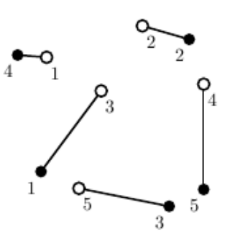

Example
Number of test cases
1
2
3
4
5
4
2
1
5
3
5
-42 58
44 86
7 28
99 34
-13 -59
-47 -44
86 74
68 -75
-68 60
99 -60
(44, 86)
(-68, 60)
(86, 74)
(-42, 58)
(99, 34)
(7, 28)
(-47, -44)
(68, -75)
(90, -60)
(-13, -59)

Slide 7
Perfect Bipartite Matching
Argument Path
1
A
1
A
1
A
2
B
2
B
2
B
3
C
3
C
3
C
4
D
4
D
4
D
5
E
5
E
5
E

Slide 8
Perfect Bipartite Matching
4
D
3
A
1
B
4
D
3
A
1
B
1
A
1
A
1
A
2
B
2
B
2
B
3
C
3
C
3
C
4
D
4
D
4
D
5
E
5
E

Slide 9
Perfect Bipartite Matching
Perfect Matching
Not Perfect Matching
1
A
1
A
2
B
if
2
B
5

E
3
C
3
C
4
D
4
D
5
E
5
E
From Node 5,
we cannot find an Argument Path

Slide 10
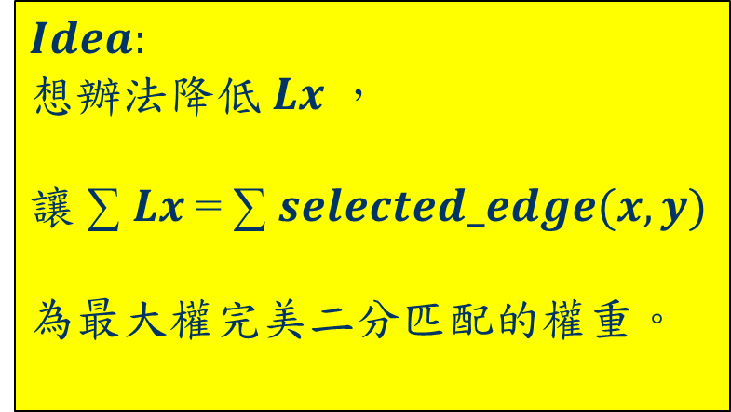
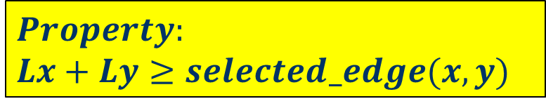
Equality Edge
label
label
Lx
Ly
5
5
5
1
A
0
3
5
1
A
0
-3
6
2
2
B
0
$$Property:$$
$$Lx+Ly≥selected_edge(x,y)$$
6
4
4
3
C
0
-2
$$Idea:$$
想辦法降低$Lx$，
讓 ∑ $Lx$= ∑ $selected_edge(x,y)$
為最大權完美二分匹配的權重。
3
3
4
D
0
6
6
5
E
0
1

Slide 11
Maximum Weight Perfect Bipartite Matching
label
label
label
label
5
5
5
1
A
5
1
A
0
5
1
A
0
3
3
3
-3
-3
-3
2
2
B
6
2
2
B
0
6
2
2
B
0
6
6
6
4
4
4
3
C
4
3
C
0
4
3
C
0
-2
-2
-2
3
3
3
4
D
3
4
D
0
3
4
D
0
6
6
6
5
E
6
5
E
0
6
5
E
0
1
1
1
X
Y
X
Y

Slide 12
Maximum Weight Perfect Bipartite Matching
label
label
4
0
5
0
5
4
5
3
5+0-3=2
5
1
A
0
3
A
1
B
3
-2
-3
6
2
2
B
0
0
5
0
6
5
2
5+0-2=3
D
2
C
4
4
3
C
0
-2
4
0
5
0
4
5
3
5+0-3=2
3
3
A
1
B
3
4
D
0
-2
-2
+2
6
2
2
3
0
6
5
E
0
4
5
3
5+0-3=2
1
3
A
1
B
X
Y
2
2
3
0
4
5
3
5+0-3=2
3
A
1
B

Slide 13
Maximum Weight Perfect Bipartite Matching
label
label
2
2
3
0
5
4
5
3
5+0-3=2
3
1
A
2
3
A
1
B
3
-3
6
2
2
B
0
6
4
2
3
C
0
-2
3
3
4
D
0
6
6
5
E
0
1
X
Y

Slide 14
Maximum Weight Perfect Bipartite Matching
label
label
3
0
6
0
5
3
6
2
6+0-2=4
3
1
A
2
4
D
2
C
3
-3
-4
+4
-4
6
2
2
B
0
6
-1
4
2
0
4
3
6
2
6+0-2=4
4
D
2
C
2
3
C
0
-2
-1
4
2
0
6
2
3
4
D
2
C
3
4
D
0
6
6
5
E
0
1
X
Y

Slide 15
Maximum Weight Perfect Bipartite Matching
label
label
3
0
6
0
5
3
6
2
6+0-2=4
3
1
A
2
4
D
2
C
3
-3
-4
+4
-4
2
2
2
B
0
6
-1
4
2
0
4
3
6
2
6+0-2=4
4
D
2
C
2
3
C
0
-2
-1
4
2
0
6
2
3
4
D
2
C
-1
4
D
4
6
6
5
E
0
1
X
Y

Slide 16
Maximum Weight Perfect Bipartite Matching
label
label
6
0
5
1
6+0-1=5
3
1
A
2
5
E
3
-5
-3
2
2
2
B
0
6
1
0
1
4
5
E
2
3
C
0
-2
3
-1
4
D
4
6
1
5
E
0
1
X
Y

Slide 17
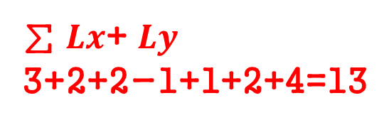
Maximum Weight Perfect Bipartite Matching
label
label
0
0
5
5
6+0-1=5
3
1
A
2
5
E
3
-3
2
2
2
B
0
Maximum Weight
Perfect Matching
3+2+4+3+1=13
6
4
2
3
C
0
-2
3
-1
4
D
4
∑ $Lx$+ $Ly$
3+2+2-1+1+2+4=13
6
1
5
E
0
1
X
Y

Slide 18
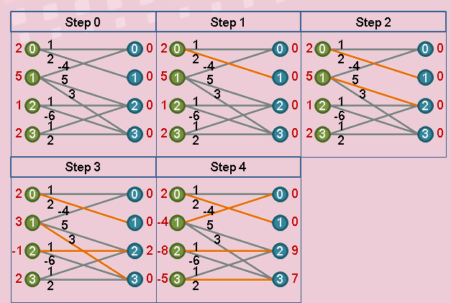
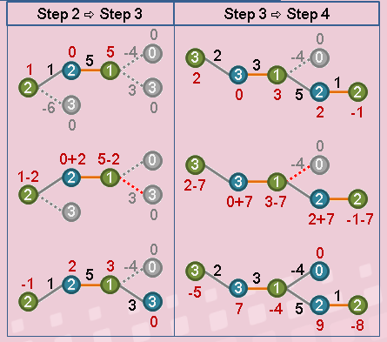

Slide 19
Kuhn-Munkres (KM) Algorithm
label
label
int W[maxn][maxn];
int Lx[maxn], Ly[maxn]; //label
int left[maxn];
bool S[maxn], T[maxn];
bool match( int i)
{ S[i]=true;
for (int j=1; j<=n; j++)
{ if (Lx[i]+Ly[j]==W[i][j] && !T[j])
T[j]=true;
if (!left[j] || match(left[j]))
{ left[j]=i;
return true;
}
}
return false;
}
S
Lx
Ly
T
left
2
0
3
1
4
5

Slide 20
Kuhn-Munkres (KM) Algorithm
void update()
{ int a=1<<30;
for (int i=1; i<=n; i++)
{ if (S[i])
for (int j =1; j <=n; j++)
if (!T[j])
a=min(a, Lx[x]+Ly[j]-W[i][j]);
}
for (int i=1; i<=n; i++)
{ if (S[i] Lx[i]-=a;
if (T[i] Ly[i]+=a;
}
}

Slide 21
Kuhn-Munkres (KM) Algorithm
void KM()
{ for (int i=1; i<=n; i++)
{ left[i] = Lx[i] = Ly[i] =0;
for (int j=1; j<=n; j++)
Lx[i] = max(Lx[i], W[i][j]);
}
for (int i=1; i<=n; i++)
{ for (;;)
{ for (int j=1; j<=n; j++)
if (match(i)) break;
else update();
}
}
}

Slide 22




Solution KM Algorithm
dist(1,1)
$$dist(a_{1},b_{1})+dist(a_{2},b_{2})≤dist(a_{1},b_{2})+dist(a_{2},b_{1})$$
1
1
2
2
Without Intersection
3
3
$$dist(a_{2},b_{1})$$
4
4
a1
a2
$$dist(a_{1},b_{1})$$
$$dist(a_{2},b_{2})$$
b1
b2
$$dist(a_{1},b_{2})$$

Slide 23
Uva 11456 Trainsorting
i | 0 | 1 | 2 | 3 | 4 | 5 | 6 | 7
A[i] | 5 | 1 | 2 | 4 | 3 | 7 | 6 | 8
LIS[i] |  |  |  | 3
LDS[i] |  |  |  | 2
3+2-1=4
8
7
4
3
i | 0 | 1 | 2 | 3 | 4 | 5 | 6 | 7
A[i] | 5 | 1 | 2 | 4 | 3 | 7 | 6 | 8
LIS[i] |  |  | 4
LDS[i] |  |  | 1
4+1-1=4
8
7
3
2

Slide 24
Uva 11456 Trainsorting
LIS[i]: 找比A[i]大的數字最大的
LDS[i]: 找比A[i]小的數字最大的
i | 0 | 1 | 2 | 3 | 4 | 5 | 6 | 7
A[i] | 5 | 1 | 2 | 4 | 3 | 7 | 6 | 8
LIS[i] |  |  |  |  |  | 2 | 2 | 1
LDS[i] |  |  |  |  |  | 2 | 1 | 1
i | 0 | 1 | 2 | 3 | 4 | 5 | 6 | 7
A[i] | 5 | 1 | 2 | 4 | 3 | 7 | 6 | 8
LIS[i] |  |  |  |  | 3 | 2 | 2 | 1
LDS[i] |  |  |  |  | 1 | 2 | 1 | 1

Slide 25
Uva 11456 Trainsorting
LIS[i]: 找比A[i]大的數字最大的
LDS[i]: 找比A[i]小的數字最大的
i | 0 | 1 | 2 | 3 | 4 | 5 | 6 | 7
A[i] | 5 | 1 | 2 | 4 | 3 | 7 | 6 | 8
LIS[i] |  |  |  | 3 | 3 | 2 | 2 | 1
LDS[i] |  |  |  | 2 | 1 | 2 | 1 | 1

